Slide 1
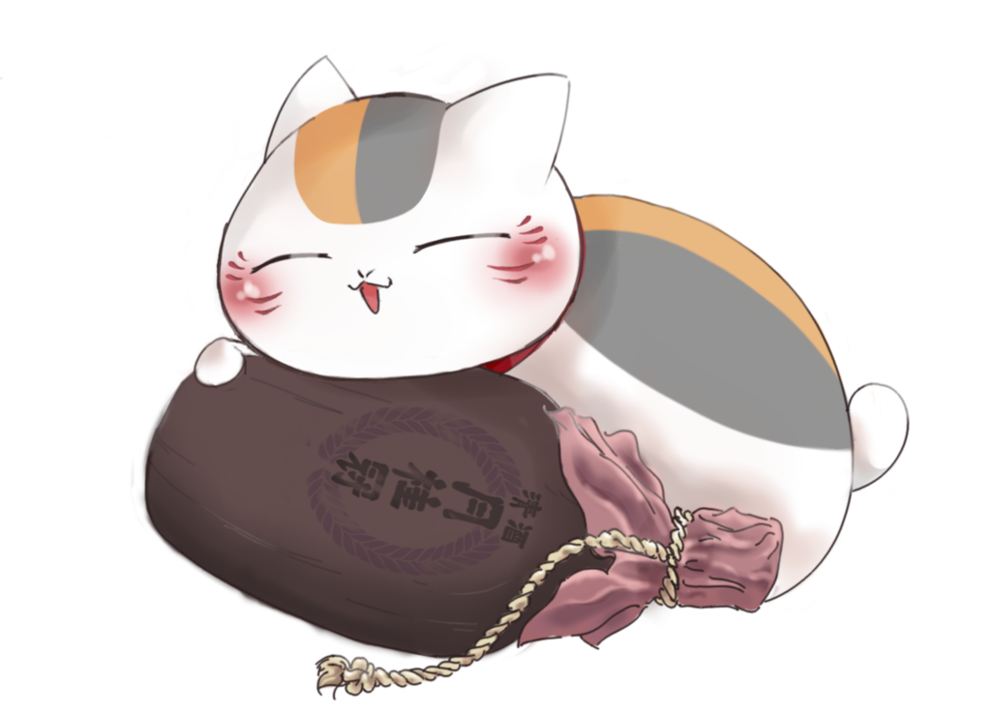

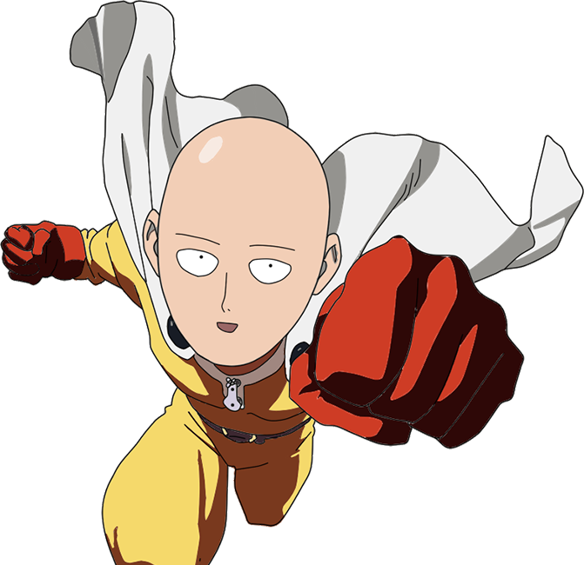
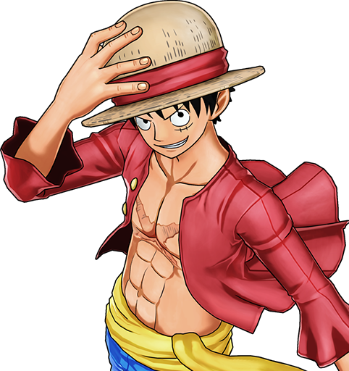

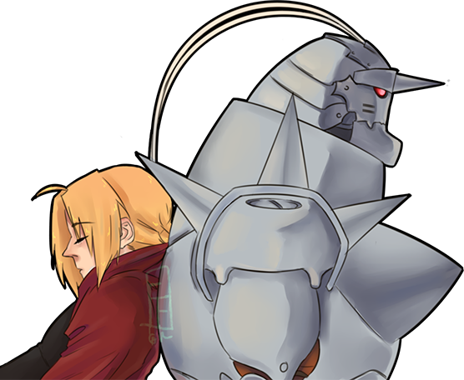

Credit: slideshare
The role of
myth in culture
AN ANIME PERSPECTIVE

Slide 2

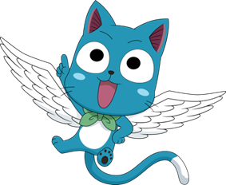
Credit: slideshare
WHAT IS INCLUDED….
WHAT IS MYTH
WHAT IS ANIME
MISCONCEPTIONS
SIGNIFICANCE
Myth and anime

Slide 3


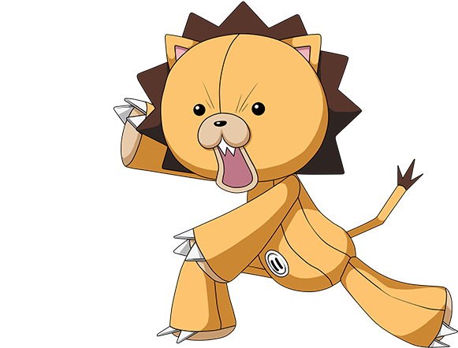
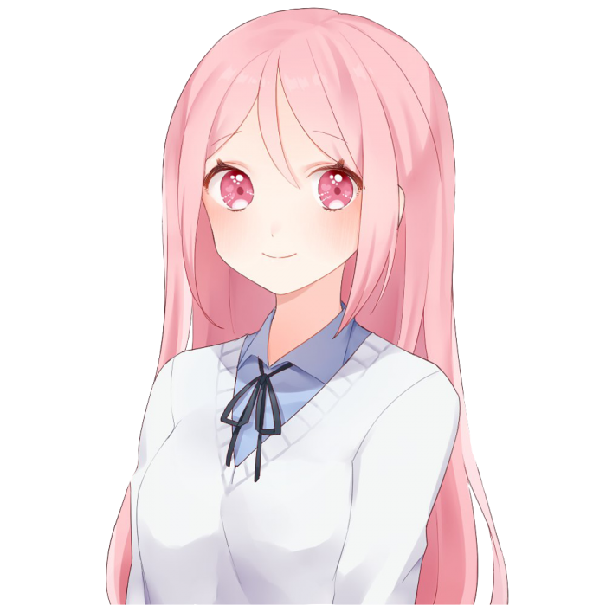

Credit: slideshare
WHAT IS MYTH
A myth is a traditional or recurrent narrative theme or plot structure shared among members of a particular culture. It often involves gods, goddesses, heroes, and supernatural elements.
Symbolism: Myths use symbols to convey deeper meanings and universal truths.
Cultural Significance: Reflect the values, beliefs, and norms of a society.
Heroes and Deities: Typically feature larger-than-life characters with godlike qualities.
Explains Origins: Often provide explanations for natural phenomena, customs, and rituals

Slide 4



Credit: slideshare
WHAT IS ANIME
Simply put, anime is animation from Japan
Anime is a medium, not a genre. Saying “I like anime is synonymous to saying “I like movies”. It includes the same genre as every other medium: drama, romance, comedy, spots, action, horror, sci-fi, fantasy, erotica and so on.
So basically, Anime could be seen as Japan’s “Hollywood”

Slide 5
Credit: slideshare
MISCONCEPTION
Anime is for kids
You are a nerd / weird if you watch anime
Anime = Violent / Pornography / big eyes / big breast / big eyes / big robots

Slide 6
Credit: slideshare
significance
Cultural Diversity: Anime explores diverse cultures, traditions, and perspectives.
Breaking Stereotypes: Challenges conventional storytelling norms.
Global Fusion: Blends Japanese and global elements, creating a unique cultural amalgamation.
Artistic Inspiration: Influences contemporary art and graphic design.
Digital Innovation: Pioneers in digital animation techniques.
Virtual Reality (VR): Anime's influence on VR experiences
Historical Themes: Some anime explore historical events and periods.

Slide 7
Credit: slideshare
Sources
http://wikipedia.org
http://anime-source.com
www.Awn.com/mag/issue1.5/articles/pattern1.5.html
https://www.tech-wonders.com/2019/07/7-common-misconceptions-about-anime.html#google_vignette

Slide 8

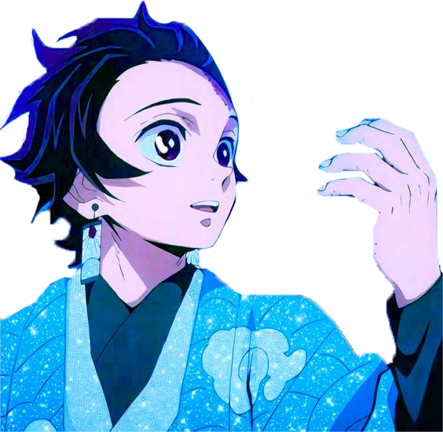
Credit: slideshare
THANK YOU

